Slide 1
What is a Statistic????
Sample
Sample
Population
Sample
Sample
Parameter: value that describes a population
Statistic: a value that describes a sample

Slide 2
Descriptive & Inferential Statistics
Descriptive Statistics
Organize
Summarize
Simplify
Presentation of data
Inferential Statistics
Generalize from samples to pops
Hypothesis testing
Relationships among variables
Describing data
Make predictions

Slide 3
Types of statistics
Descriptive statistics – Methods of organizing, summarizing, and presenting data in an informative way
Inferential statistics – The methods used to determine something about a population on the basis of a sample
Population –The entire set of individuals or objects of interest or the measurements obtained from all individuals or objects of interest
Sample – A portion, or part, of the population of interest

Slide 4
Descriptive Statistics
3 Types
1. Frequency Distributions
3. Summary Stats
# of Ss that fall
in a particular category
Describe data in just one
number
2. Graphical Representations
Graphs & Tables

Slide 5
SPREAD (dispersion)
SPREAD (dispersion)
Range
Symmetric distributions
Standard deviation
Variance
Skewed distributions
Quartiles
Min
Max
Interquartile range
Percentiles

Slide 6
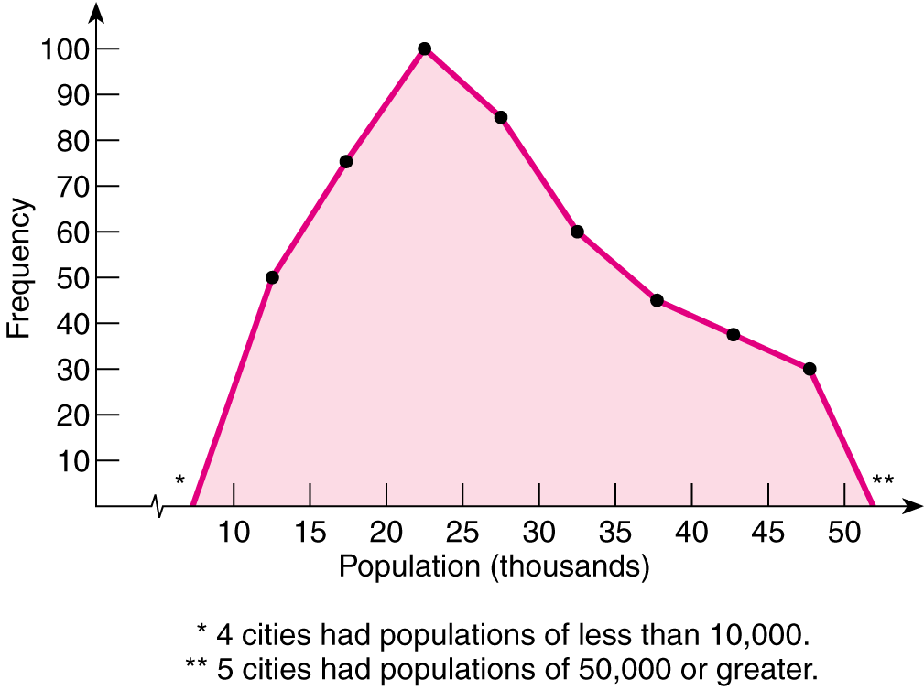
Frequency Polygons
Frequency Polygons
Depicts information from a frequency table or a grouped frequency table as a line graph

Slide 7
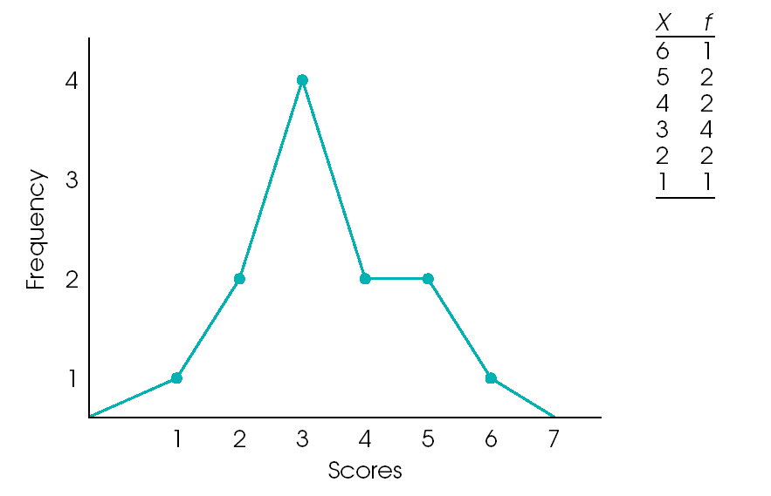
Frequency Polygon
A smoothed out histogram
Make a point representing f of each value
Connect dots
Useful for comparing distributions in two samples

Slide 8
Describing distributions
SHAPE
Graphs
Histograms
Stem and leaf plots
Box plots
Number of Modes
Variation
Words
Symmetric, skewed, bell shaped, flat, peaked

Slide 9
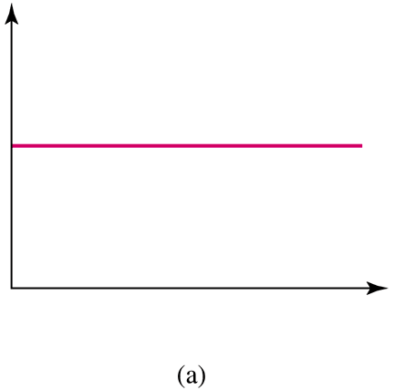
Number of Modes
One way to describe the shape of a distribution is by its number of peaks, or modes.
Uniform distribution—has no mode because all data values have the same frequency.

Slide 10
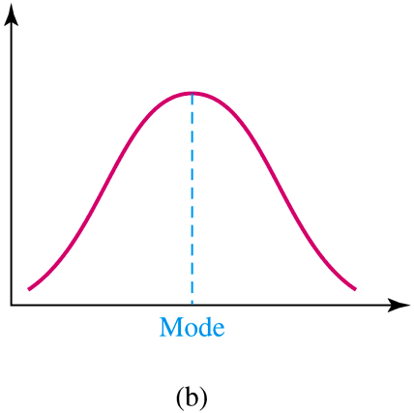
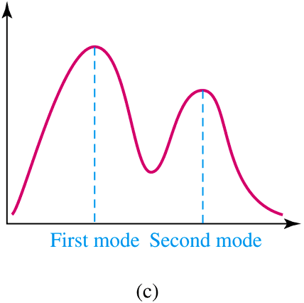
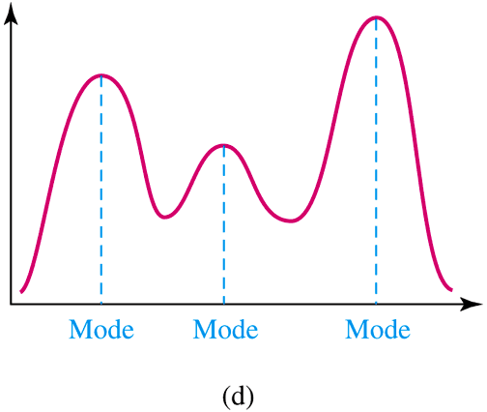
Any peak is considered a mode, even if all peaks do not have the same height.
A distribution with a single peak is called a single-peaked, or unimodal, distribution.
A distribution with two peaks, even though not the same size, is a bimodal distribution.
What is the following distribution?

Slide 11
Symmetrical vs. Skewed Frequency Distributions
Symmetrical distribution
Approximately equal numbers of observations above and below the middle
Skewed distribution
One side is more spread out that the other, like a tail
Direction of the skew
Positive or negative (right or left)
Side with the fewer scores
Side that looks like a tail

Slide 12
Symmetry
The shape of the distribution is said to be symmetric if the observations are balanced, or evenly distributed, about the center; coefficient of skewness equal zero
When the distribution is unimodal, the mean, median, and mode are all equal to one another and are located at the center of the distribution

Slide 13
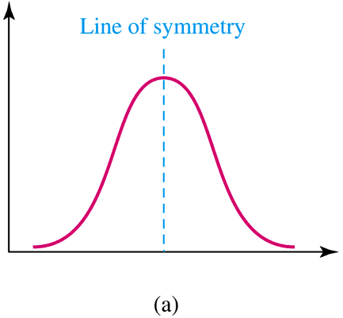
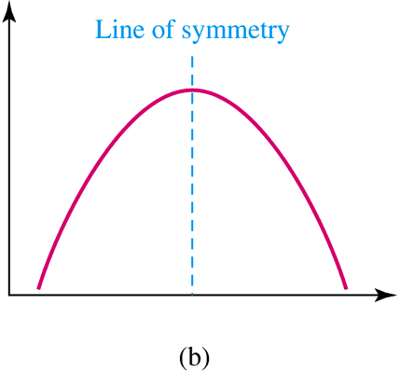
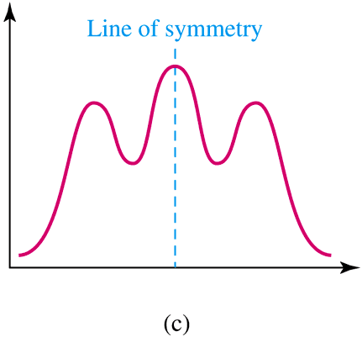
Symmetry
A distribution is symmetric if its left half is a mirror image of its right half.
A symmetric distribution with a single peak and a bell shape is known as a normal distribution.

Slide 14
Skewness
The shape of the distribution is said to be skewed if the observations are not symmetrically distributed around the center.
A positively skewed distribution (skewed to the right) has a tail that extends to the right in the direction of positive values.
A negatively skewed distribution (skewed to the left) has a tail that extends to the left in the direction of negative values.

Slide 15
Symmetrical vs. Skewed
Symmetric
Skewed Right
Skewed Left

Slide 16
Skewed Frequency Distributions
Positively skewed
Skewed right
Tail trails to the right
*** The skew describes the skinny end ***

Slide 17
Skewed Frequency Distributions
Negatively skewed
Skewed left
Tail trails to the left

Slide 18
Shape of a Distribution
Describes how data are distributed
Measures of shape
Symmetric or skewed
Left-Skewed
Symmetric
Right-Skewed
Mean < Median < Mode
Mean = Median = Mode
Mean <Median < Mode

Slide 19
Shape of Distribution
Shape of distribution is measured by
Skewness
Kurtosis

Slide 20
Skewness
Measures asymmetry of data
Positive or right skewed: Longer right tail
Negative or left skewed: Longer left tail

Slide 21
Kurtosis
Measures peakedness of the distribution of data. The kurtosis of normal distribution is 0.

Slide 22
Skewness
Shows asymmetry and refers to the shape of a distribution
Can take on positive, negative or zero values

Slide 23
Outlier
An outlier falls far from the rest of the data

Slide 24
OUTLIERS
Recall that an outlier is an extremely small or extremely large data value when compared with the rest of the data values.
The following procedure allows us to check whether a data value can be considered as an outlier.

Slide 25
Procedure to Check for OUTLIERS
The following steps will allow us to check whether a given value in a data set can be classified as an outlier.
Step 1: Arrange the data in order from smallest to largest.
Step 2: Determine the first quartile Q₁ and the third quartile Q₃. (Recall Q₁ = P₂₅ and Q₃ = P₇₅.

Slide 26
Procedure to Check for OUTLIERS
Step 3: Find the interquartile range (IQR). IQR = Q₃ – Q₁.
Step 4: Compute (Q₁ – 1.5×IQR) and (Q₃ + 1.5×IQR).

Slide 27
Procedure to Check for OUTLIERS
Step 5: Let x be the data value that is being checked to determine whether it is an outlier.
(a) If the value of x is smaller than (Q₁ – 1.5×IQR), then x is classified as an outlier.
(b) If the value of x is larger than (Q₃ + 1.5×IQR), then x is classified as an x is an outlier.

Slide 28
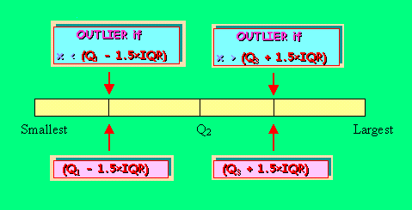
Procedure to Check for OUTLIERS

Slide 29
Example
The data below represent the 20 countries with the largest number of total Olympic medals, including the United States, which had 101 medals for the 1996 Atlanta games. Determine whether the number of medals won by the United States is an outlier relative to the numbers for the other countries.
The data is given on the next slide.

Slide 30
Example (continued)
Data values – 63, 65, 50, 37, 35, 41, 25, 23, 27, 21, 17, 17, 20, 19, 22, 15, 15, 15, 15, 101.
Solution: First, we need to arrange the data set in order. The ordered set is – 15 15 15 15 17 17 19 20 21 22 23 25 27 35 37 41 50 63 65 101.
Next we need to determine the first and third quartiles.
Verify that Q₁ = P₂₅ = 17 and Q₃ = P₇₅ = 39.

Slide 31
Example (continued)
Thus the IQR = 39 – 17 = 22.
Now, Q₁ – 1.5×IQR = 17 – (1.5×22) = -16.
and, Q₃ + 1.5×IQR = 39 + (1.5×22) = 72.
Since, 101 > 72, the value of 101 is an outlier relative to the rest of the values in the data set (based on the procedure presented here).
That is, the number of medals won by the United States is an outlier relative to the numbers won by the other 19 countries for the 1996 Atlanta Olympic Games.

Slide 32
Pictorial Representation for the OUTLIER of the Number of Olympic Medals Won by the United States in 1996 Atlanta Games.
101
OUTLIER
-16
+72

Slide 33
Outliers based on z-scores
When we consider the empirical rule an observation with a z-score < -2.00 or z-score > 2.00 might be characterized as a mild outlier.
Any observation with a z-score < - 3.00 or z-score > 3.00
might be characterized as an extreme outlier.

Slide 34
Standard Deviation
Most important measure of variation
Shows variation about the mean
Has the same units as the original data
Sample standard deviation:
Population standard deviation:

Slide 35
Comparing Standard Deviations
Data A
Mean = 15.5
s = 3.338
11 12 13 14 15 16 17 18 19 20 21
Data B
Mean = 15.5
s = .9258
11 12 13 14 15 16 17 18 19 20 21
Data C
Mean = 15.5
s = 4.57
11 12 13 14 15 16 17 18 19 20 21

Slide 36
Coefficient of Variation
Measures relative variation
Always in percentage (%)
Shows variation relative to mean
Is used to compare two or more sets of data measured in different units

Slide 37
Comparing Coefficient of Variation
Stock A:
Average price last year = $50
Standard deviation = $5
Stock B:
Average price last year = $100
Standard deviation = $5
Coefficient of variation:
Stock A:
Stock B:

